Slide 1
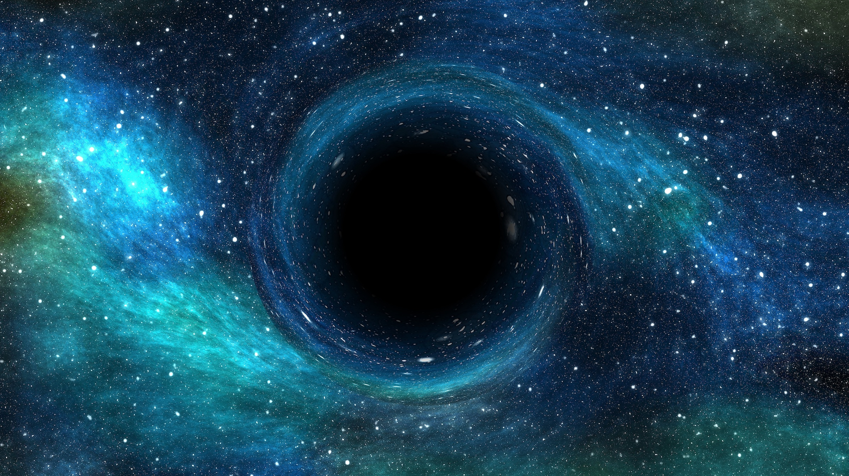
Project Aether

Slide 2

Problem

Slide 3
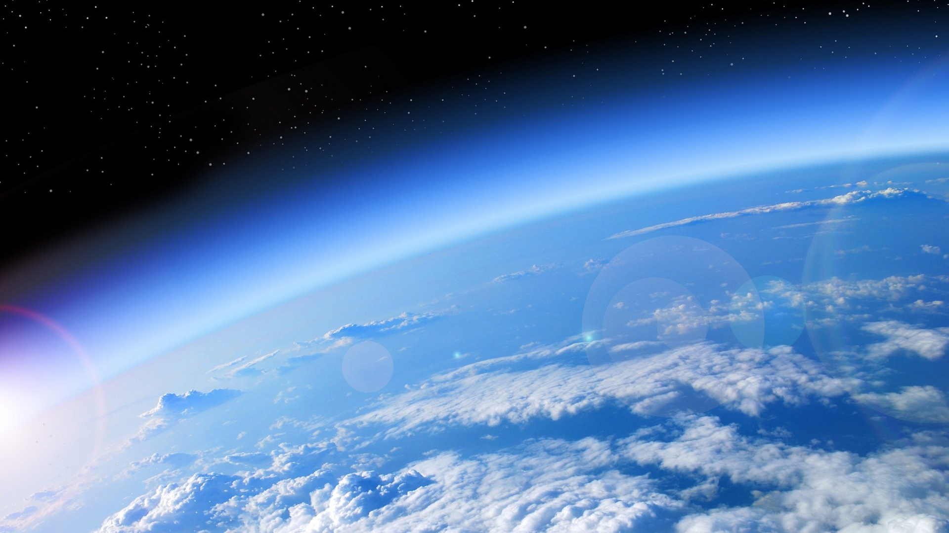
Harnessing Power
Harsh Weather
Agricultural Issues

Slide 4
No non-reusable sources available
Harsh Weather
Agricultural Issues

Slide 5
No non-reusable sources available
Harsh Weather
Agricultural Issues

Slide 6

Our Solution

Slide 7
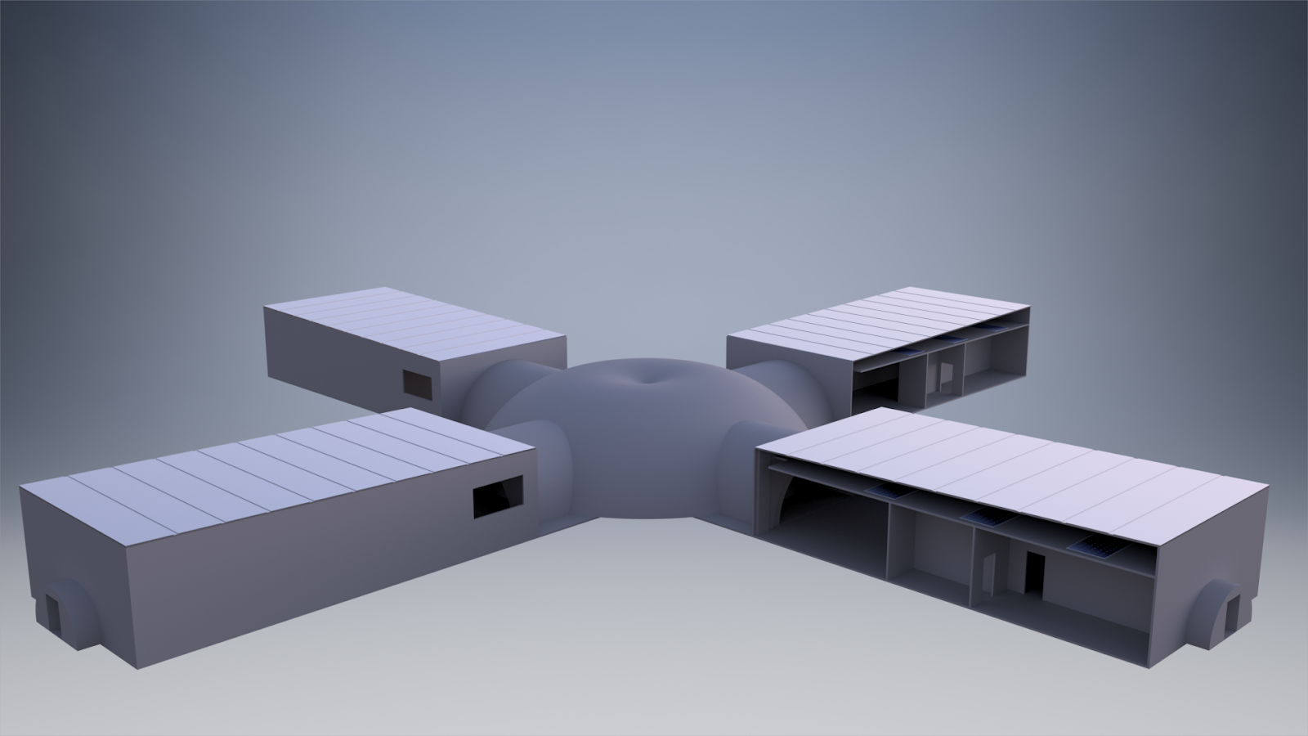

Slide 8
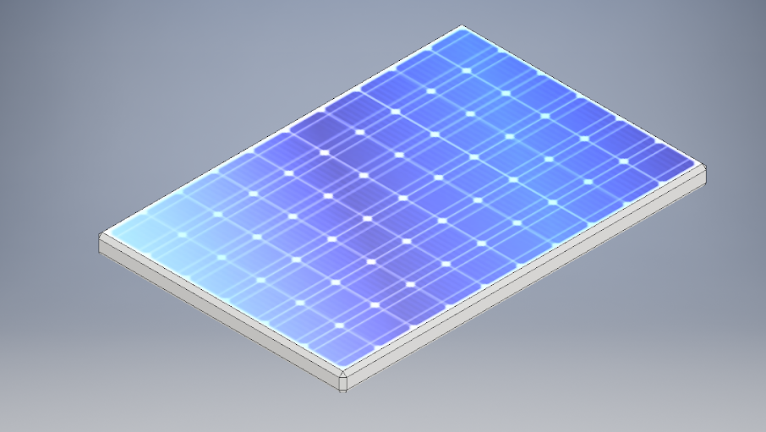
Solar Energy

Slide 9
Solar Tarp System

Slide 10

Harnessing Wind

Slide 11

Feasibility

Slide 12
Challenges

Slide 13
Future

